Slide 1
Kilobyte to Gigabyte Scale
By Thomas Booth

Slide 2

Квас(Kvas)
This is Kvas! It’s an extremely popular eastern-European drink that is effectively composed of fermented bread. Specifically rye bread, rye flour, rye malt, barely malt, citric acid, water and sugar. It’s generally very refreshing to drink, however, as it does taste a lot like bread it definitely isn’t for everyone. It was first invented in ancient Rus and has been a favourite drink of every class of living since.

Slide 3
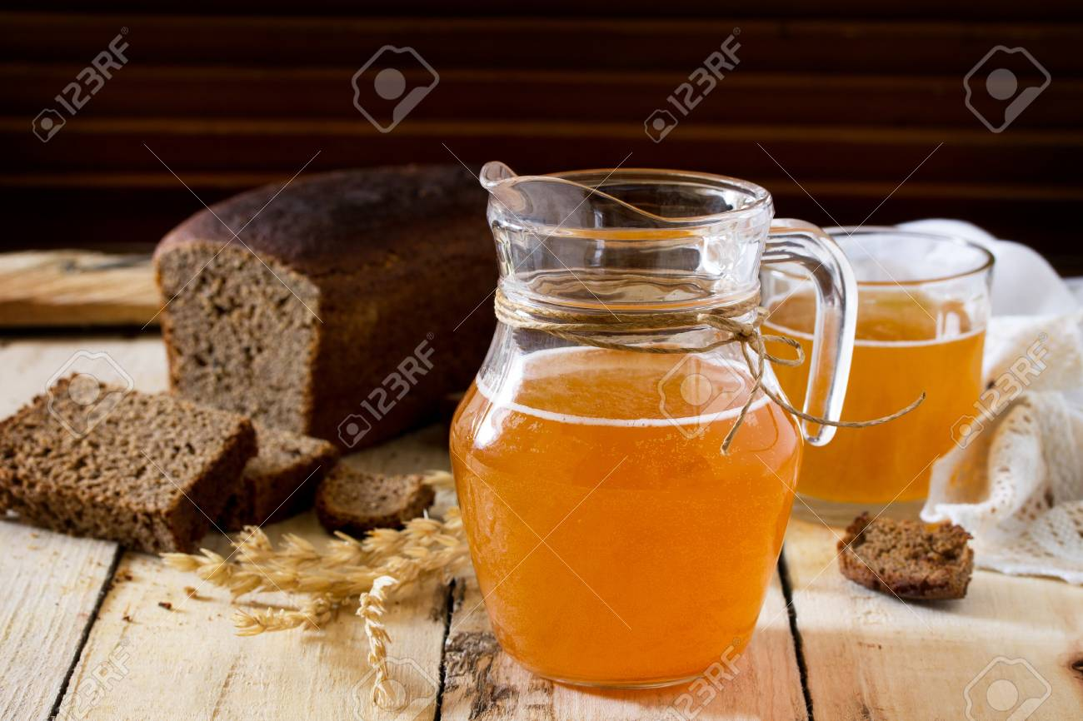
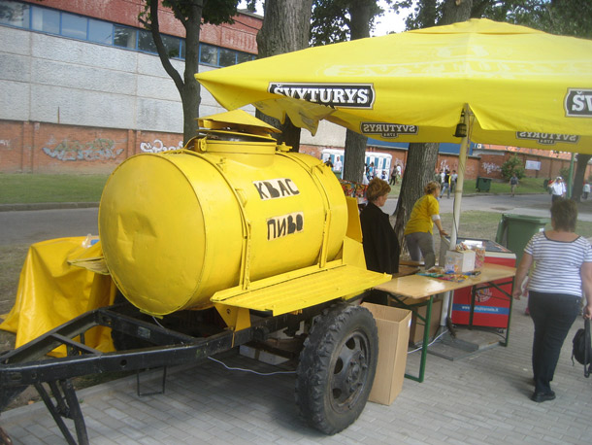
The Scale
Lets say here that thus jug of Kvas contains one megabyte of data, meaning hypothetically each drop equals 1 kilobyte for 1000 kilobytes to be in one megabyte. A 1000:1 ratio
Then if this gigantic barrel of Kvas contains 1000 jugs from my previous image it would contain a gigabyte worth of data. Another 1000:1 ratio.

Slide 4
Summary
1 drop of Kvas = A kilobyte of data
1000 drops of Kvas fills a jug which makes 1000 kilobytes to become 1 megabyte of data per jug.
1000 jugs fills a barrel which makes 1000 megabytes to become a single gigabyte!

